Slide 1
Resource Allocation in Wireless Cellular Networks
M. Rasti
Amirkabir University of Technology

Slide 2
Course Syllabus
I- Basics of Wireless Networks
1- Introduction of Wireless Networks and Radio Resources
2- Categories of Wireless Networks and Taxonomy of Hot Topics Research Areas on Resource Allocation in Wireless Networks
II- Techniques for Modeling and Analysis of Radio Resource Allocation in Wireless Networks
3- Convex Optimization
4- Game Theory
III- Physical Layer Resource Allocation in Wireless Networks
5- General System Model and Preliminary Concepts
6- Power Control in Wireless Cellular Networks
7- Joint Power and Admission Control in Cellular Wireless Networks
8- Cell Association and Power Control in Cellular Networks
9- Application of Game Theory in Physical Layer Resource Allocation in Wireless Networks
10- Joint Power and Admission Control in Cognitive Radio Network

Slide 3
Lecture 8 Outline
System Model
Joint Power Control and Base Station Assignment Problem Statement
Distributed Power Control and Base Station Assignment Algorithm
Open Problems

Slide 4
References
R.D Yates, and C. Huang, “Integrated power control and base station assignment”, IEEE Transactions on Vehicular Technology, 1995
S. V. Hanly, “An algorithm for combined cell-site selection and power control to maximize cellular spread spectrum capacity”, IEEE Journal on Selected Areas in Communications, 1995

Slide 5
General System Model
General Multicell
M users (mobile station (MS)) establish links to K base station
Each user is served by one of the K BSs

Slide 6

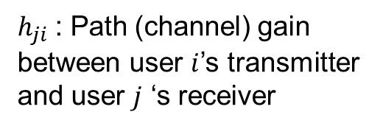
Multicell Networks (Uplink)
$h_{ji}$: Path (channel) gain between user $i$’s transmitter and user $j$ ‘s receiver
h_{ii}
i
h_{i1}
1
h_{j1}
h_{ij}
h_{2i}
h_{j2}
2
h_{ij}
h_{jj}
j
We make a little change in this notation!
$${h_{ji}\underset{→}{ }h}_{s_{j}i}$$

Slide 7
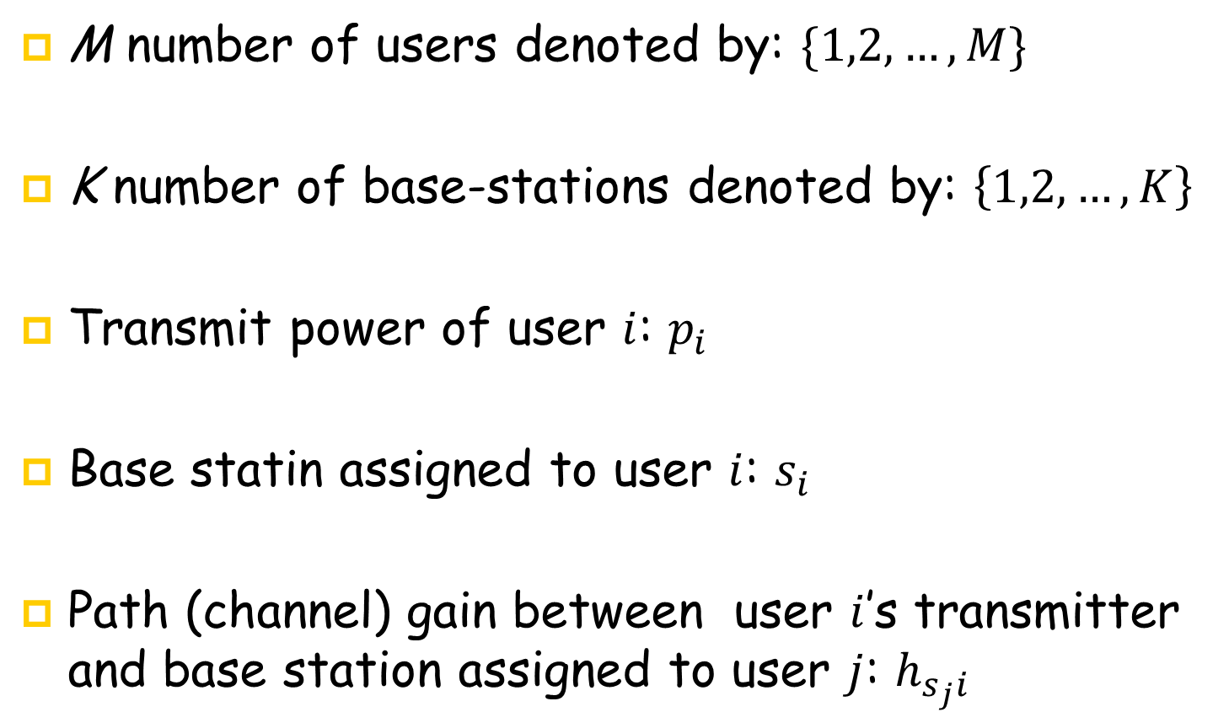
Multicell System Model
M number of users denoted by: $\{1,2,…,M\}$
K number of base-stations denoted by: $\left\{1,2,…,K\right\}$
Transmit power of user $i$: $p_{i}$
Base statin assigned to user $i$: $s_{i}$
Path (channel) gain between user $i$’s transmitter and base station assigned to user $j$: $h_{s_{j}i}$

Slide 8
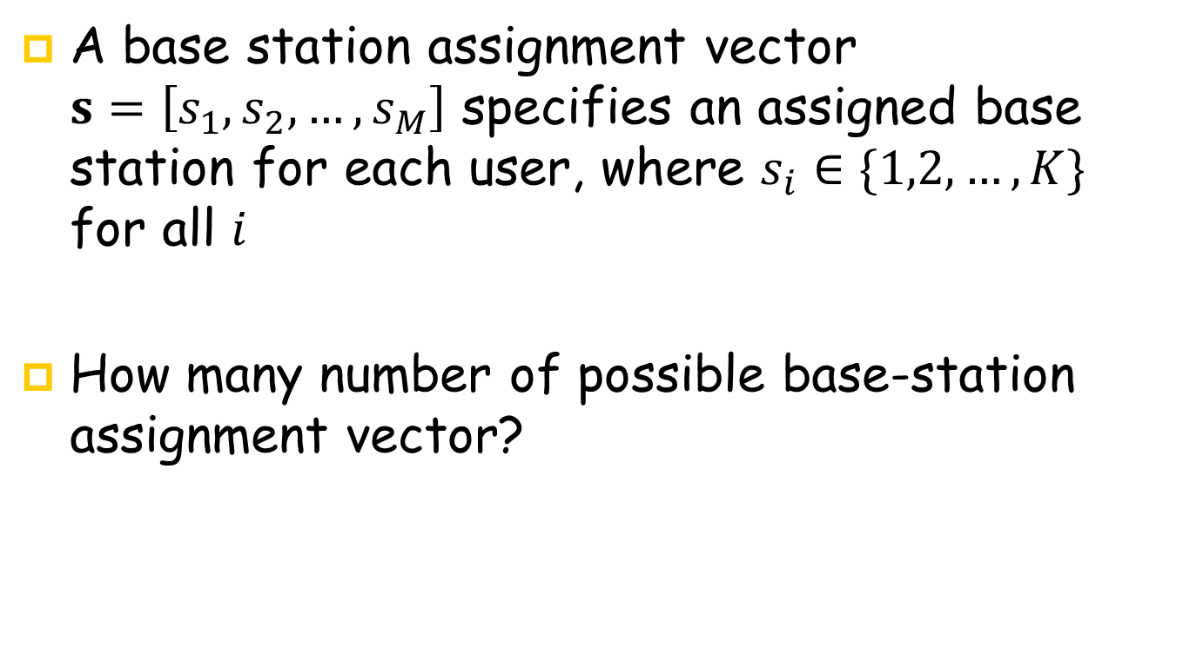
Multicell System Model
A base station assignment vector $s=\left[s_{1}, s_{2},…,s_{M}\right]$ specifies an assigned base station for each user, where $s_{i}∈\{1,2,…,K\}$ for all $i$
How many number of possible base-station assignment vector?
Notes:
M to N

Slide 9
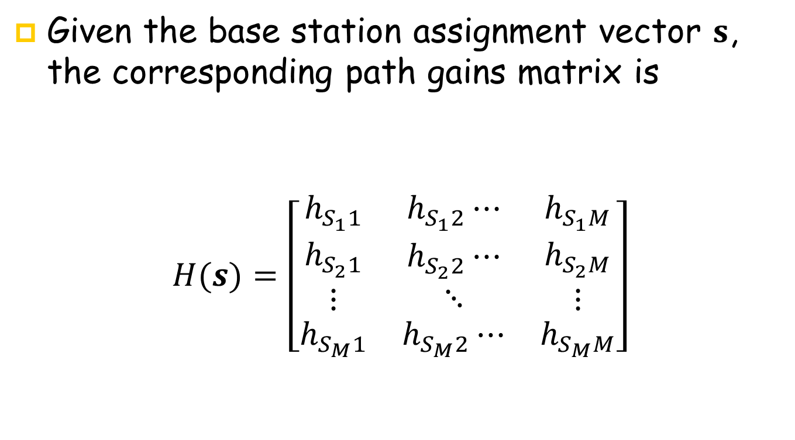
Multicell System Model
Given the base station assignment vector $s$, the corresponding path gains matrix is
$$H(s)=\left[\begin{matrix}h_{S_{1}1} & h_{S_{1}2}⋯ & h_{S_{1}M} \\ \begin{aligned}h_{S_{2}1} \\ ⋮\end{aligned} & \begin{aligned}h_{S_{2}2}⋯ \\ ⋱\end{aligned} & \begin{aligned}h_{S_{2}M} \\ ⋮\end{aligned} \\ h_{S_{M}1} & h_{S_{M}2}⋯ & h_{S_{M}M}\end{matrix}\right]$$

Slide 10
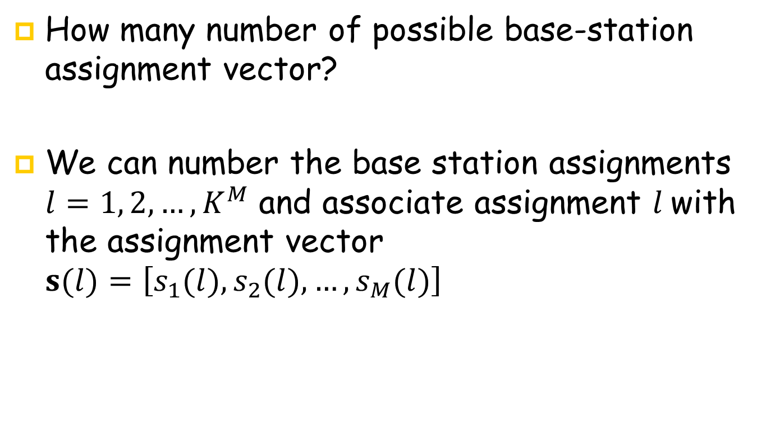
Multicell System Model
How many number of possible base-station assignment vector?
We can number the base station assignments $l=1, 2,…,K^{M}$ and associate assignment $l$with the assignment vector $s(l)=\left[s_{1}(l), s_{2}(l),…,s_{M}(l)\right]$
Notes:
M to N

Slide 11

Multicell System Model
Given the $l$-th base station assignment vector $s(l)$, the corresponding path gains matrix is
$$H^{(l)}=H(s(l))$$

Slide 12

Multicell System Model
SIR achieved by user $i$ at its assigned base station $s_{i}$
$$γ_{i}=\frac{p_{i}h_{s_{i}i}}{\sum_{j≠i}{p_{j}h_{s_{i}j}+v_{s_{i}}}}$$
Notes:
We have not defined notation \gamma _ik as SINR of user i at base station k, because we don’t need it.

Slide 13
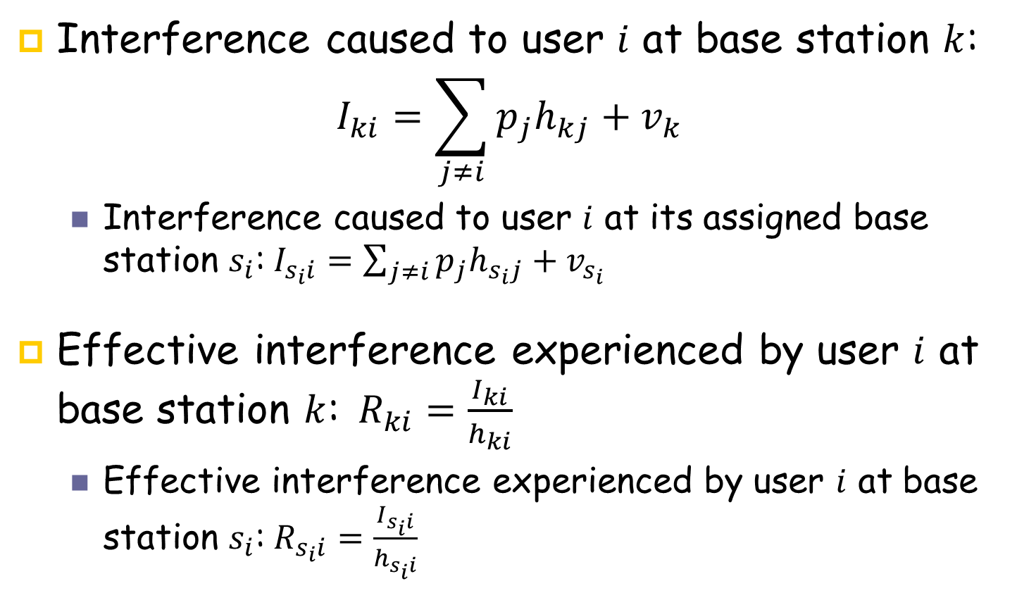
Multicell System Model
Interference caused to user $i$ at base station $k$:
$$I_{ki}=\sum_{j≠i}{p_{j}h_{kj}+v_{k}}$$
Interference caused to user $i$ at its assigned base station $s_{i}$:$I_{s_{i}i}=\sum_{j≠i}{p_{j}h_{s_{i}j}+v_{s_{i}}}$
Effective interference experienced by user $i$ at base station $k$:$R_{ki}=\frac{I_{ki}}{h_{ki}}$
Effective interference experienced by user $i$ at base station $s_{i}$:$R_{s_{i}i}=\frac{I_{s_{i}i}}{h_{s_{i}i}}$

Slide 14

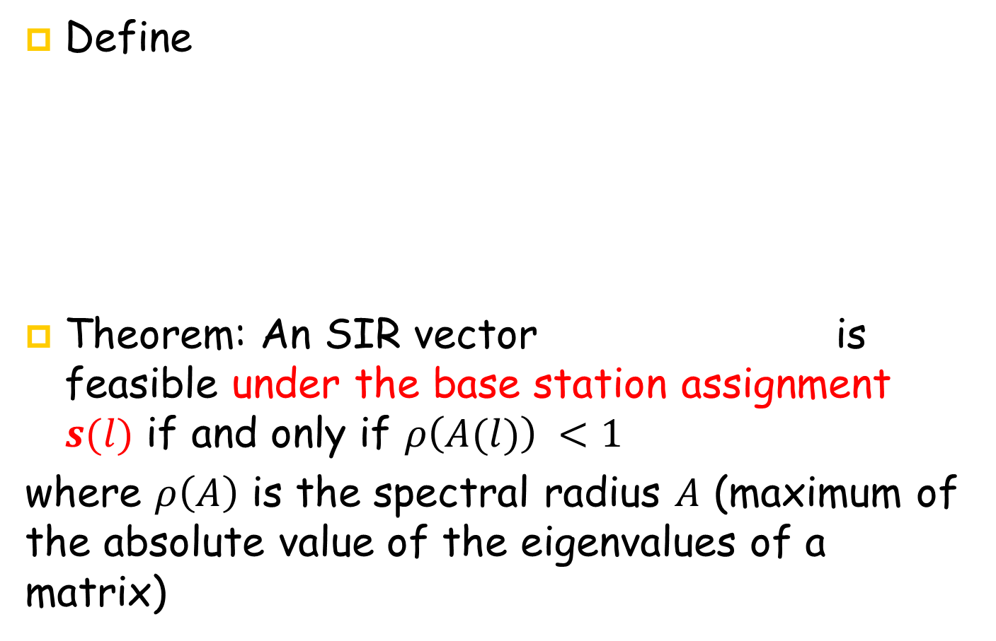
SIR feasibility in a general system model for a given assignment of base stations
Define
Theorem: An SIR vector is feasible under the base station assignment $s(l)$ if and only if $ρ\left(A(l)\right) <1$
where $ρ\left(A\right)$ is the spectral radius $A$ (maximum of the absolute value of the eigenvalues of a matrix)
$$A\left(l\right)=\left[\begin{matrix}0 & \frac{h_{s_{1}(l)2}}{h_{s_{1}(l)1}}⋯ & \frac{h_{s_{1}(l)M}}{h_{s_{1}(l)1}} \\ \begin{aligned}\frac{h_{s_{2}(l)1}}{h_{s_{2}(l)2}} \\ ⋮\end{aligned} & \begin{aligned}0⋯ \\ ⋱\end{aligned} & \begin{aligned}\frac{h_{s_{2}(l)M}}{h_{s_{2}(l)2}} \\ ⋮\end{aligned} \\ \frac{h_{s_{M}(l)1}}{h_{s_{M}(l)M}} & \frac{h_{s_{M}(l)2}}{h_{s_{M}(l)M}}⋯ & 0\end{matrix}\right]\left[\begin{matrix}γ_{1} & 0⋯ & 0 \\ \begin{aligned}0 \\ ⋮\end{aligned} & \begin{aligned}γ_{2}⋯ \\ ⋱\end{aligned} & 0 \\ 0 & 0⋯ & γ_{M}\end{matrix}\right]$$
Notes:
The mathematical expression of this idea is as follows: if A is a square matrix, a non-zero vector v is an eigenvector of A if there is a scalar λ (lambda) such that Av=\lamba V

Slide 15
Lecture 8 Outline
System Model
Joint Power Control and Base Station Assignment Problem Statement
Distributed Power Control and Base Station Assignment Algorithm
Open Problems

Slide 16
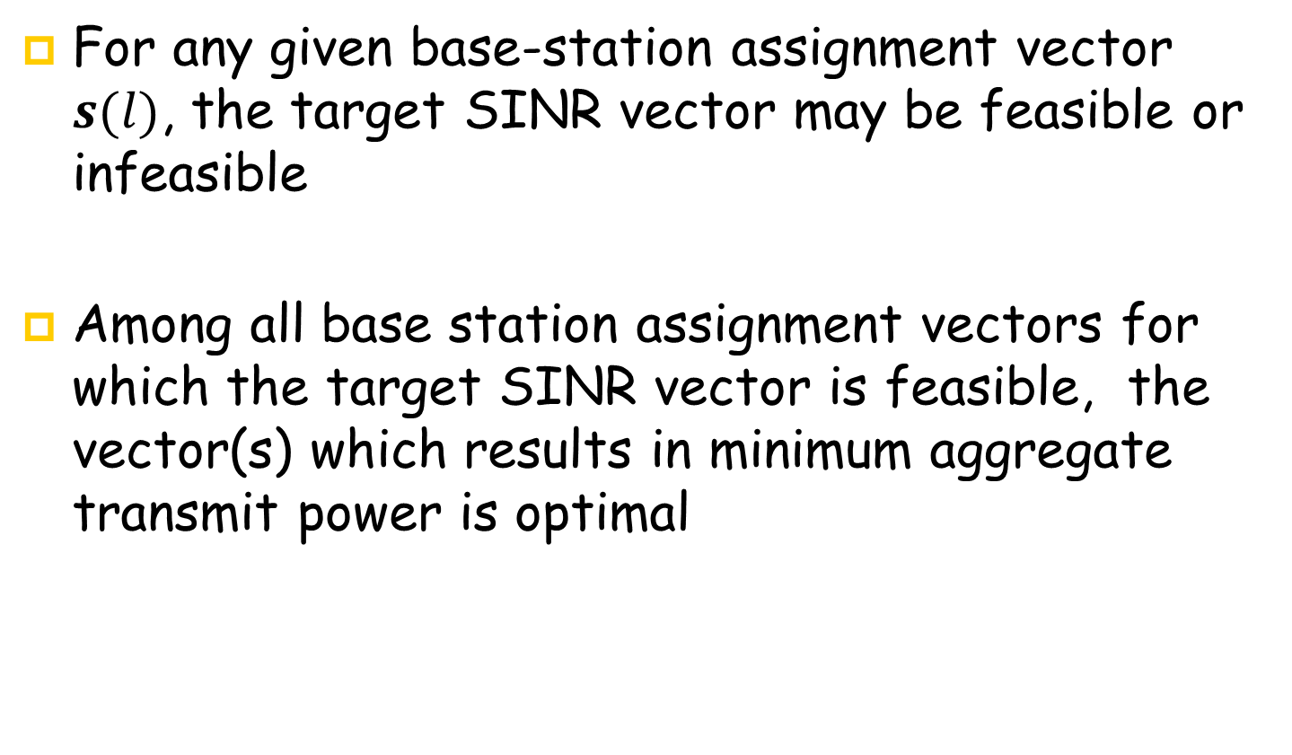
Joint Power Control and Base station assignment Problem Statement
For any given base-station assignment vector $s(l)$, the target SINR vector may be feasible or infeasible
Among all base station assignment vectors for which the target SINR vector is feasible, the vector(s) which results in minimum aggregate transmit power is optimal

Slide 17
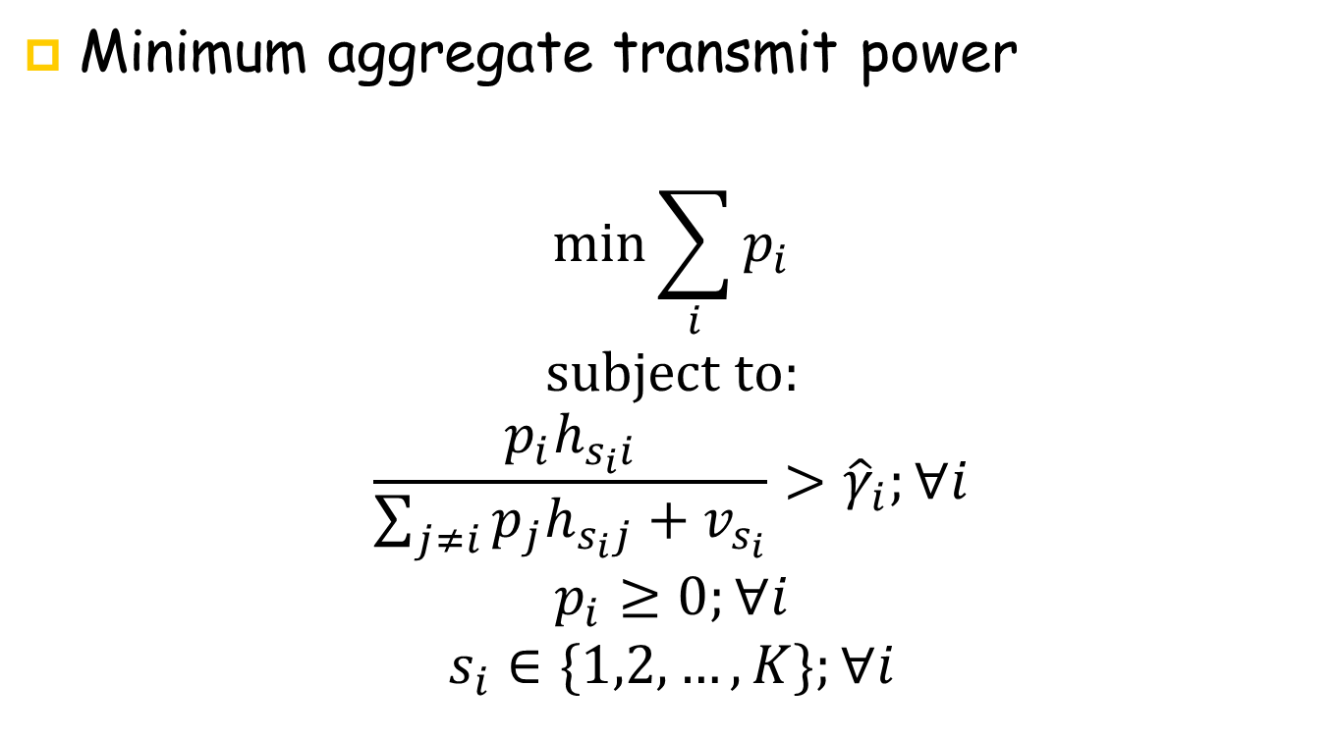
Joint Power Control and Base station assignment Problem Statement
Minimum aggregate transmit power
$$\min{\sum_{i}{p_{i}}}$$
$$subject to:$$
$$\frac{p_{i}h_{s_{i}i}}{\sum_{j≠i}{p_{j}h_{s_{i}j}+v_{s_{i}}}}>{\hat{γ}}_{i};∀i$$
$$p_{i}≥0;∀i$$
$$s_{i}∈\{1,2,…,K\};∀i$$

Slide 18
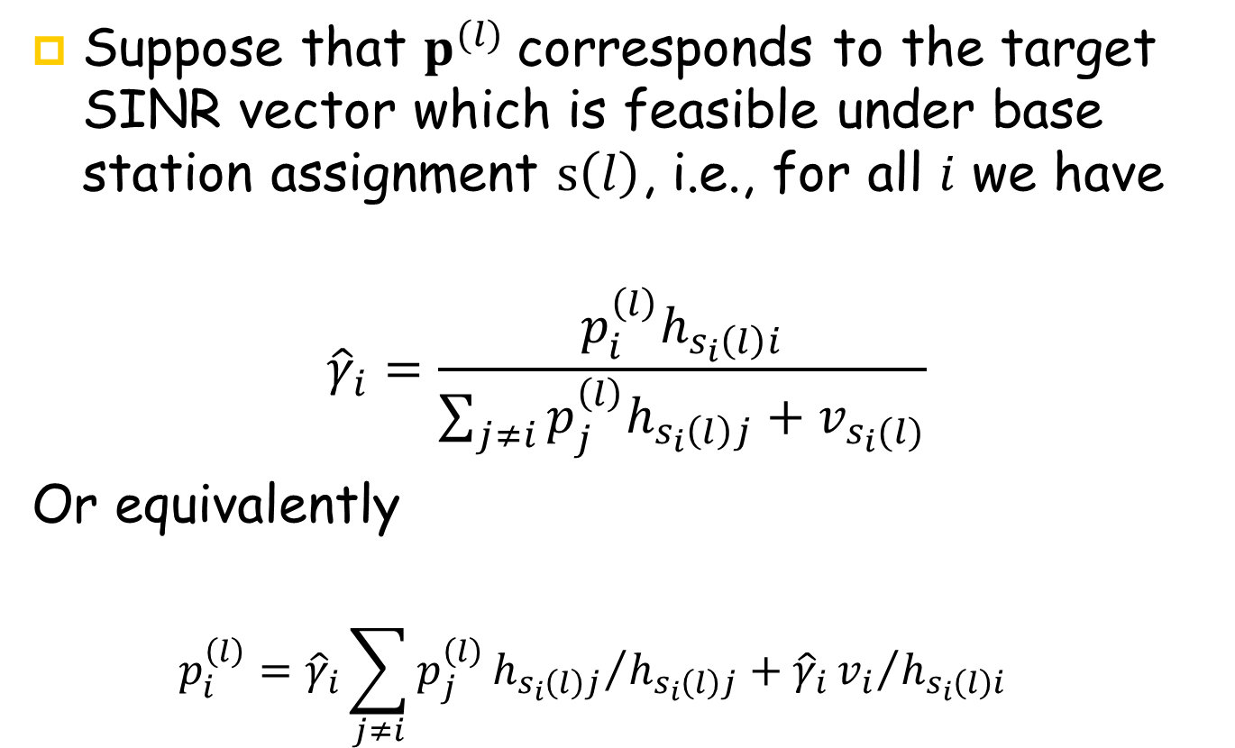
Joint Power Control and Base station assignment Problem Statement
Suppose that $p^{(l)}$corresponds to the target SINR vector which is feasible under base station assignment $s\left(l\right)$, i.e., for all $i$ we have
$${\hat{γ}}_{i}=\frac{p_{i}^{\left(l\right)}h_{s_{i}\left(l\right)i}}{\sum_{j≠i}{p_{j}^{\left(l\right)}h_{s_{i}\left(l\right)j}+v_{s_{i}(l)}}}$$
Or equivalently
$$p_{i}^{\left(l\right)}={\hat{γ}}_{i}\sum_{j≠i}{p_{j}^{\left(l\right)}{h_{s_{i}\left(l\right)j}}/{h_{s_{i}\left(l\right)j}}+{\hat{γ}}_{i}{v_{i}}/{h_{s_{i}\left(l\right)i}}}$$

Slide 19
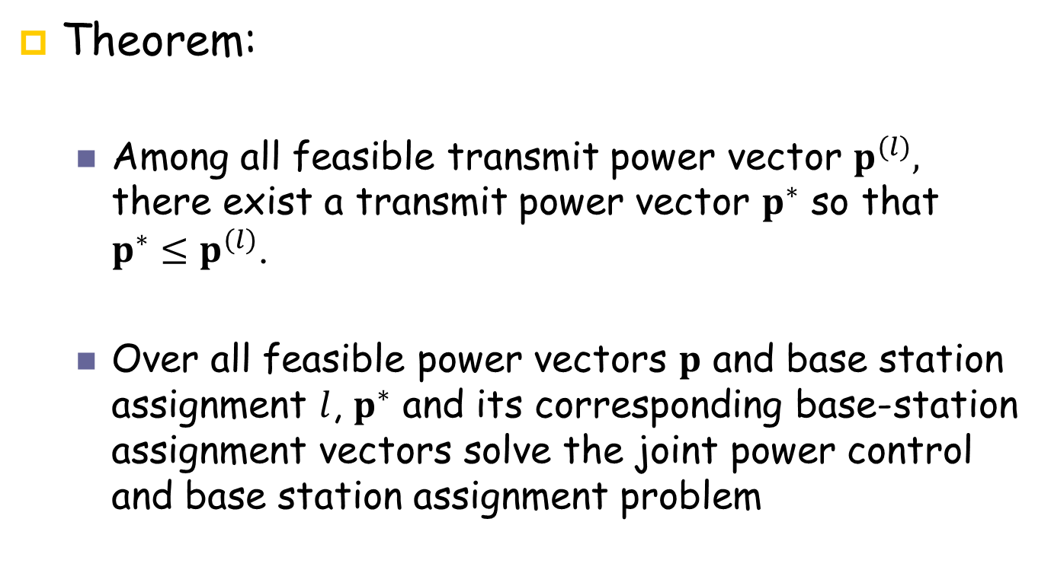
Joint Power Control and Base station assignment Problem Statement
Theorem:
Among all feasible transmit power vector $p^{(l)},$ there exist a transmit power vector $p^{∗}$ so that ${p^{∗}≤p}^{(l)}$.
Over all feasible power vectors $p$ and base station assignment $l$, $p^{∗}$ and its corresponding base-station assignment vectors solve the joint power control and base station assignment problem

Slide 20






Joint Power Control and Base station assignment Problem Statement
Example: Consider a system with two users and two base stations
$$p_{2}$$
$$p_{1}={\hat{γ}}_{1}(p_{2}h_{22}+ν)/h_{12}$$
$$p_{1}={\hat{γ}}_{1}(p_{2}h_{21}+ν)/h_{11}$$
$$p_{2}={\hat{γ}}_{2}(p_{1}h_{12}+ν)/h_{22}$$
$$p_{2}={\hat{γ}}_{2}(p_{1}h_{11}+ν)/h_{21}$$
$$p_{1}$$

Slide 21
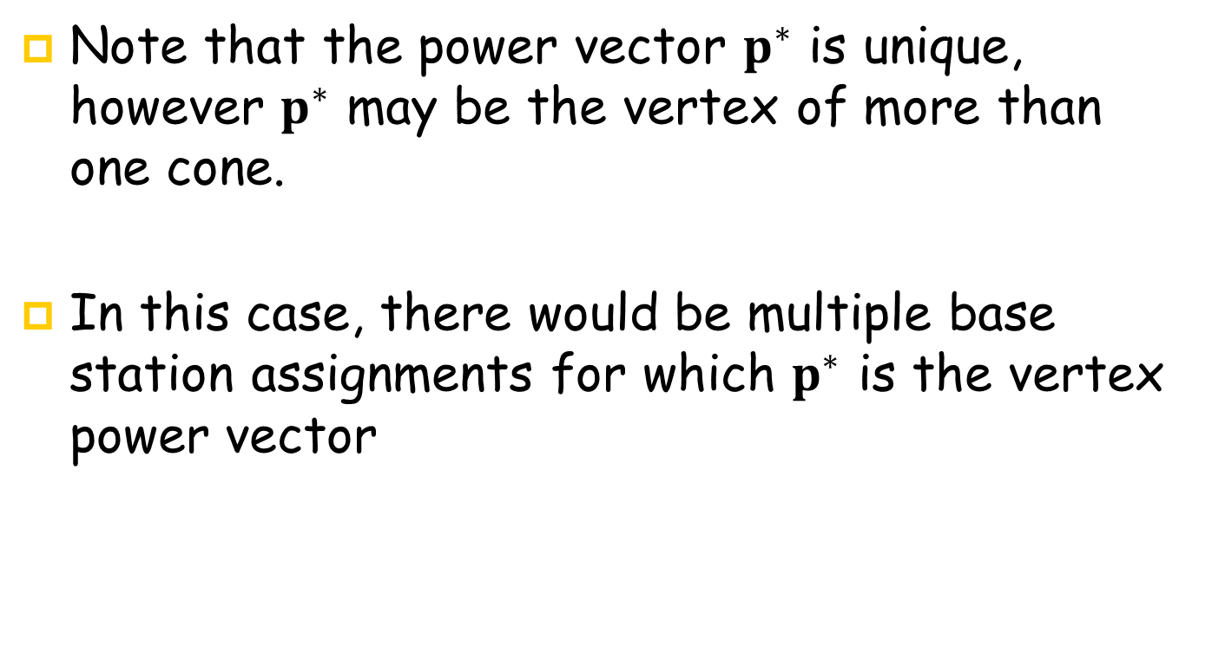
Joint Power Control and Base station assignment Problem Statement
Note that the power vector $p^{∗}$ is unique, however $p^{∗}$ may be the vertex of more than one cone.
In this case, there would be multiple base station assignments for which $p^{∗}$ is the vertex power vector

Slide 22
Lecture 6 Outline
System Model
Joint Power Control and Base Station Assignment Problem Statement
Distributed Power Control and Base Station Assignment Algorithm
Open Problems

Slide 23
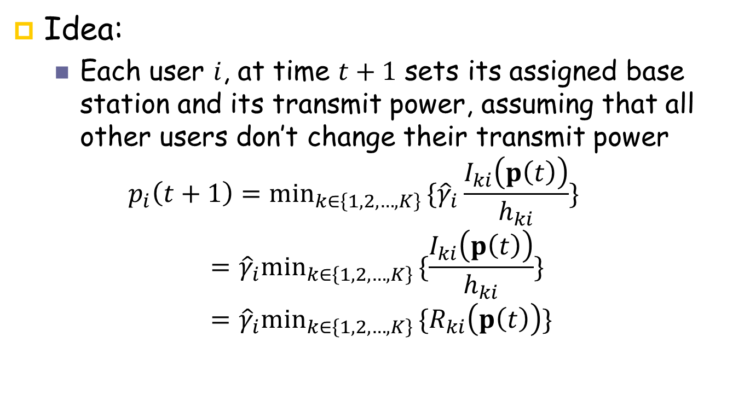
Distributed Power Control and Base-Station Assignment Algorithm
Idea:
Each user $i$, at time $t+1$ sets its assigned base station and its transmit power, assuming that all other users don’t change their transmit power
$$p_{i}\left(t+1\right)={\min_{k∈\left\{1,2,…,K\right\} }\{\hat{γ}}_{i}\frac{I_{ki}\left(p\left(t\right)\right)}{h_{ki}}\}={\hat{γ}}_{i}\min_{k∈\left\{1,2,…,K\right\} }\{\frac{I_{ki}\left(p\left(t\right)\right)}{h_{ki}}\}={\hat{γ}}_{i}\min_{k∈\left\{1,2,…,K\right\} }\{R_{ki}\left(p\left(t\right)\right)\}$$

Slide 24
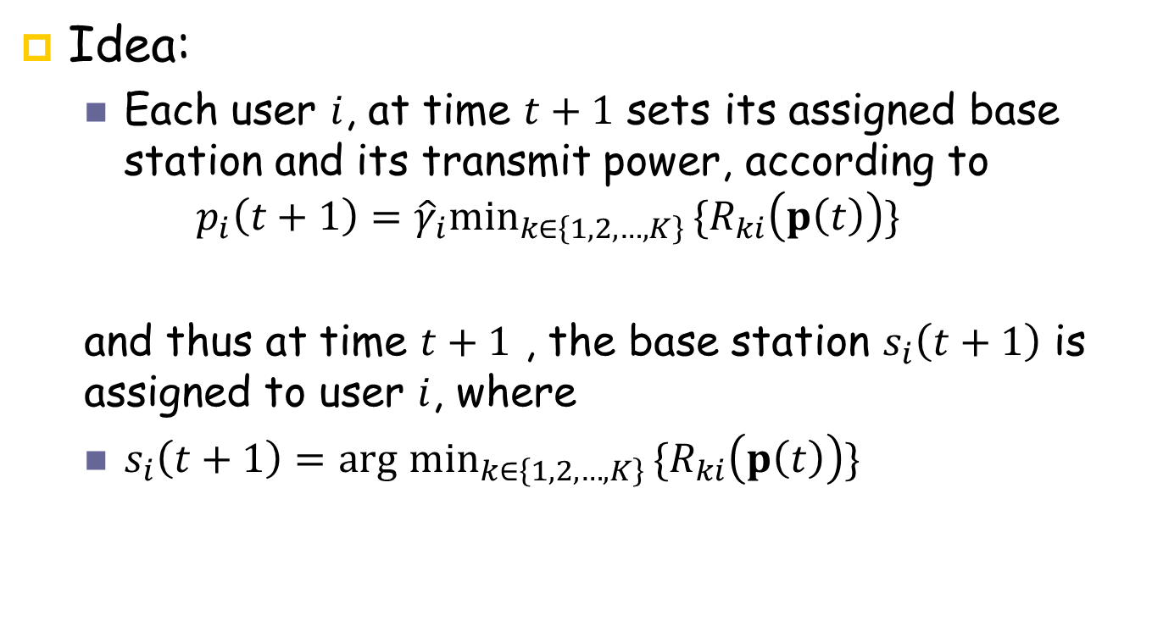
Distributed Power Control and Base-Station Assignment Algorithm
Idea:
Each user $i$, at time $t+1$ sets its assigned base station and its transmit power, according to
$$p_{i}\left(t+1\right)={\hat{γ}}_{i}\min_{k∈\left\{1,2,…,K\right\} }\{R_{ki}\left(p\left(t\right)\right)\}$$
and thus at time $t+1$ , the base station $s_{i}\left(t+1\right)$ is assigned to user $i$, where
$s_{i}\left(t+1\right)=arg$ $\min_{k∈\left\{1,2,…,K\right\} }\{R_{ki}\left(p\left(t\right)\right)\}$

Slide 25
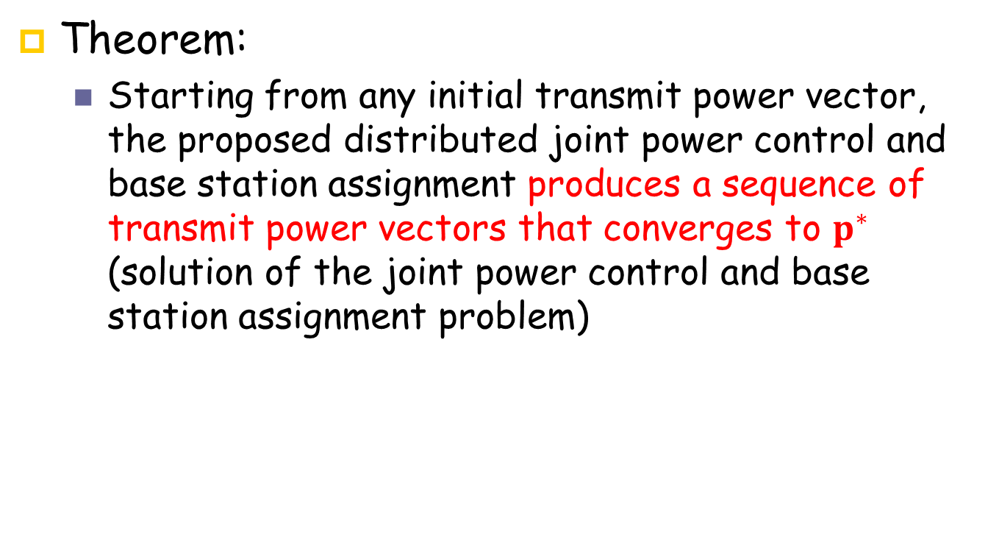
Distributed Power Control and Base-Station Assignment Algorithm
Theorem:
Starting from any initial transmit power vector, the proposed distributed joint power control and base station assignment produces a sequence of transmit power vectors that converges to $p^{∗}$ (solution of the joint power control and base station assignment problem)

Slide 26
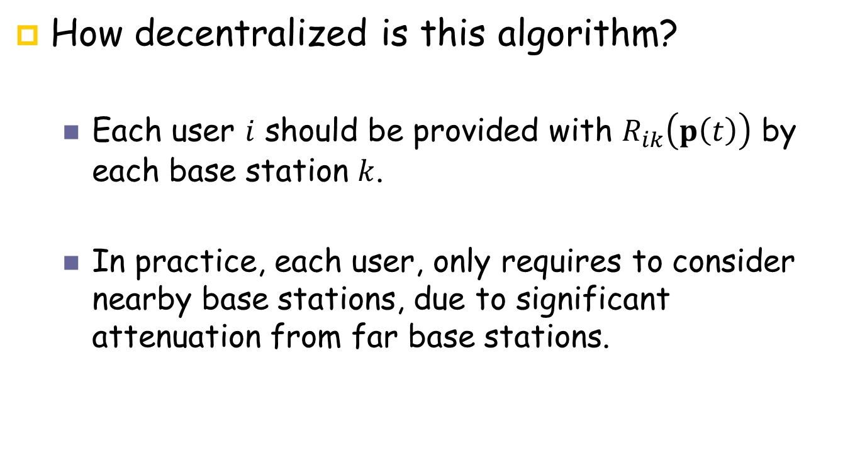
Distributed Power Control and Base-Station Assignment Algorithm
How decentralized is this algorithm?
Each user $i$ should be provided with $R_{ik}\left(p\left(t\right)\right)$ by each base station $k$.
In practice, each user, only requires to consider nearby base stations, due to significant attenuation from far base stations.

Slide 27
Lecture 5 Outline
System Model
Joint Power Control and Base Station Assignment Problem Statement
Distributed Power Control and Base Station Assignment Algorithm
Open Problems

Slide 28
Open Problems
Extending existing distributed power control algorithms to joint power control and base station assignment algorithms
Over power and base station assignment
Minimum aggregate power consumption subject to target-SIR
Minimum outage ratio
Maximizing System Throughput
Maximizing system throughput subject to a minimum target-SIR constraint
TPC (non-constrained TPC done by Hanly and Yates!)
Constrained TPC, TPC-SR, DFC, OPC, DTPC (have not been done)

Slide 29
Open Problems
Game theoretic Analysis of joint power control and base station assignment
Non-cooperative power control and base station assignment game

